Slide 1
RIC/SCBA Connection

Slide 2
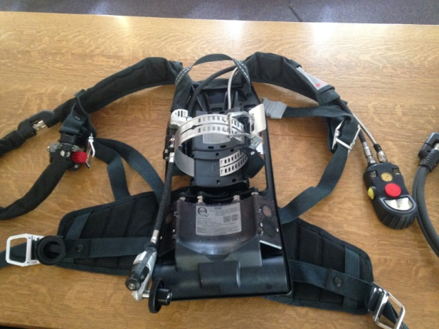
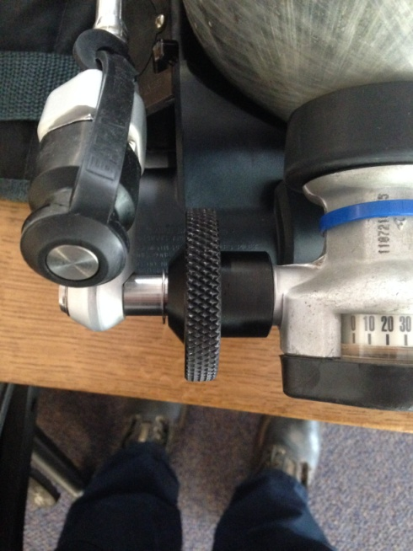
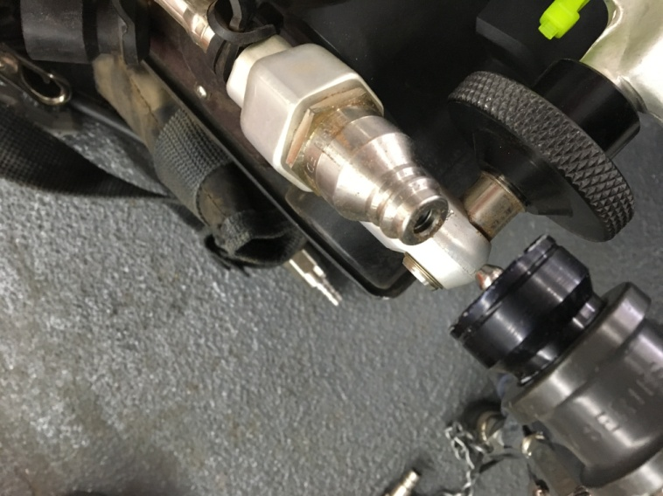
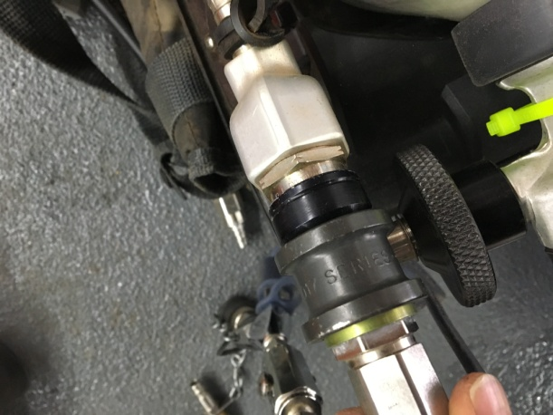
TITANS (NEW SCBA’s)
First Connection is UAC
This will for all the Titans even the ones without a buddy breather

Slide 3
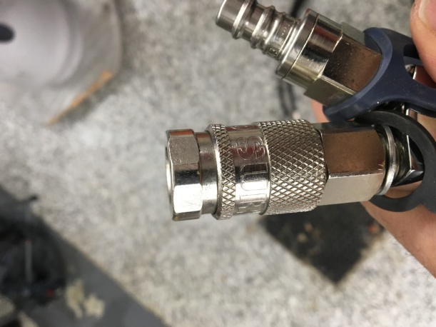
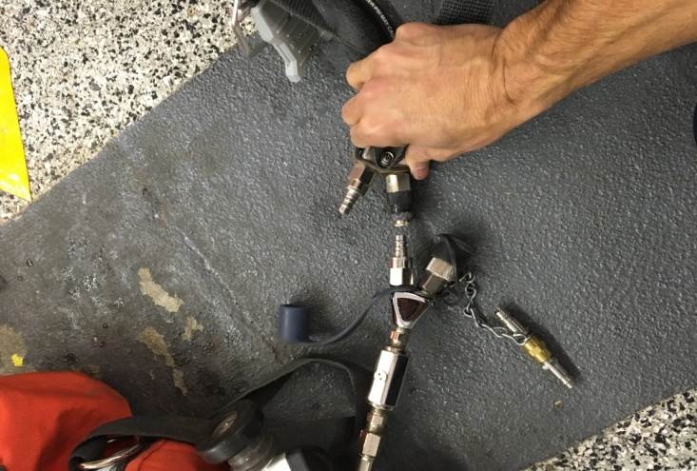
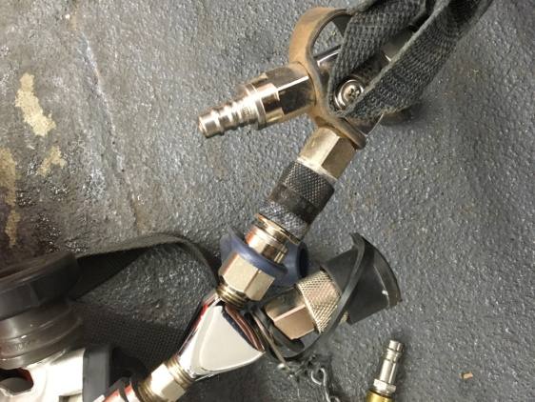
TITANS
Option 2, for ones with buddy breather. Connecting Buddy breather to RIC Buddy Breather (MALE OF RIT INTO FEMALE OF TITAN)

Slide 4
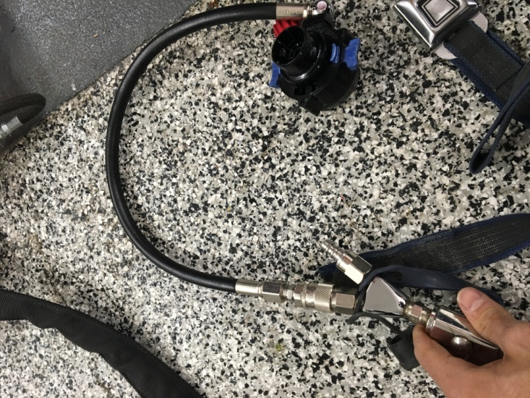
TITAN
OPTION 3 Connect Second Stage Regulator in RIC Pack to Buddy Breather on RIC pack and Connect to Fire Fighters Mask
This is your Second option for the Titans without Buddy Breathers

Slide 5
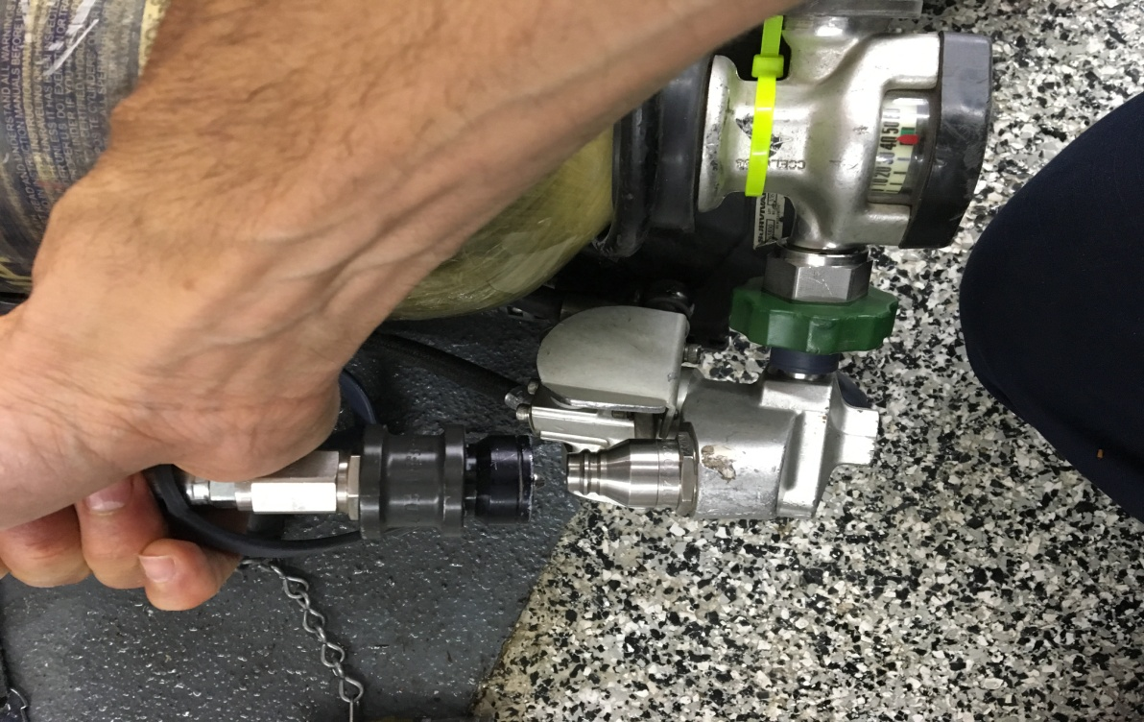
PANTHER (Older SCBA)
UAC Connection

Slide 6
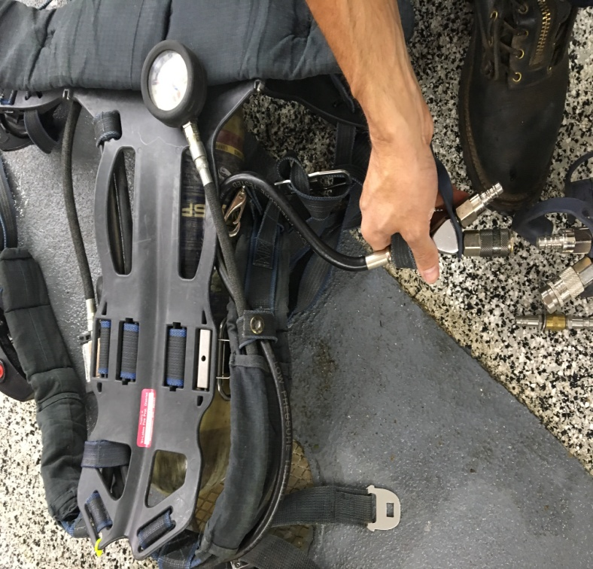
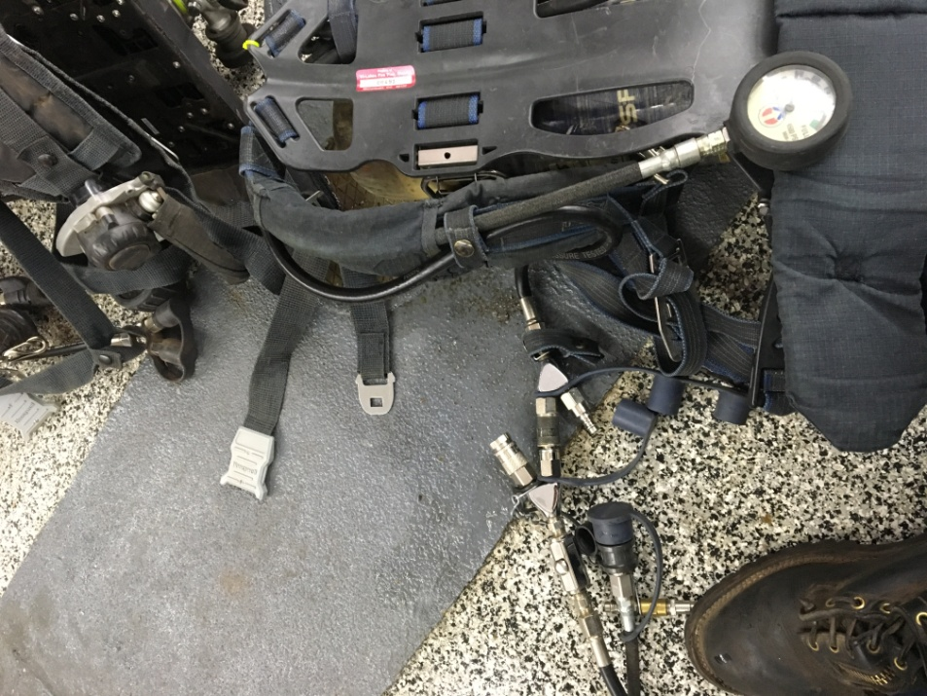
PANTHER
BUDDY BREATHER- MALE of RIC to FEMALE OF SCBA

Slide 7
PANTHER
OPTION 3 Connect Second Stage Regulator in RIC Pack to Buddy Breather (Female Coupling) on RIC pack and Connect to Fire Fighters Mask

Slide 8
FINAL NOTES
This is quick and dirty, hope this clears up some questions about the RIC
Have any questions please ask the paid staff
Spend some time with these and get use to them
For Buddy Breather to buddy breather, Remember the RIC is always the MALE (giving AIR to SCBA)
You cannot disconnect second stage from the TITANS and hook to the BUDDY BREATHER

